Slide 1
PRACTICAL EXAM
ZIMWANGUYIZZA PETER
2023-B072-21287

Slide 2
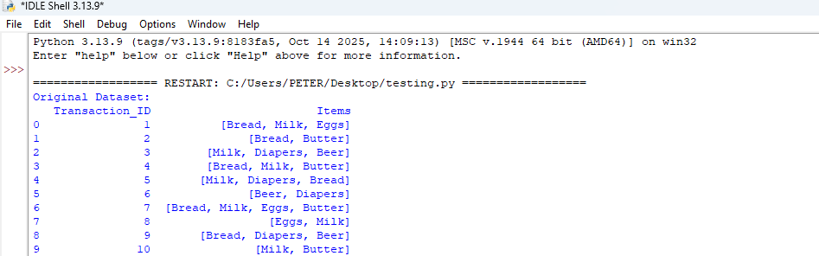
Part A: Data Preparation (4 Marks)
Load the dataset into a data frame and convert the item lists into a transaction format suitable for Apriori. (2 Marks)

Slide 3
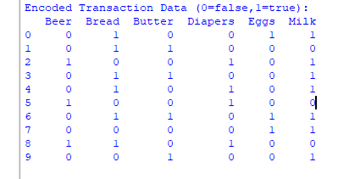
Encode the transaction data into the correct one-hot encoded format for the algorithm. (2 Marks)

Slide 4
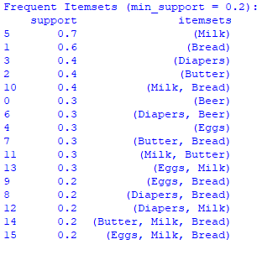
Part B: Apriori Algorithm (8 Marks)
Apply the Apriori algorithm.
Minimum support = 0.2

Slide 5
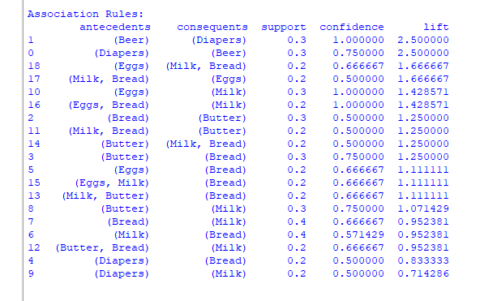
Generate association rules from the frequent itemset and display
1.Support
2.Confidence
3.Lift

Slide 6
Identify the three strongest rules based on lift and explain what each suggests about customer purchase behaviour. (4 Marks)
1. {Beer} → {Diapers}
Lift = 2.5
What it means: When someone buys beer, they almost always buy diapers too (100% of the time in this data).
Example: Think of a father going to shop on Friday evening. He buys Bell Lager or Nile Special for weekend relaxation, and also buys pampers for his baby.
Why: Weekend preparation - enjoying time at home while caring for his children.

Slide 7
2. {Diapers} → {Beer}
Lift = 2.5
What it means: When someone buys diapers, 75% chance they buy beer too.
Example: A mother going to supermarket for baby supplies. She also picks beer for her husband. Or a parent doing monthly shopping buys both items.
Why: Family shopping includes needs for both children and adults.

Slide 8
3. {Bread, Milk} → {Butter}
Lift = 1.5
What it means: When customers buy bread and milk together, 75% add butter.
Example: Someone buying bread for breakfast (maybe Ntake or tiptop) with milk (Jesa or Fresh Dairy). They complete with Blue Band butter.
Why: Complete breakfast preparation - bread, tea with milk, and butter for spreading.

Slide 9
Provide two business recommendations based on insights from the rules. (4 Marks)
To create Weekend Family Package
Put beer section near baby products in your supermarket.
Example: In Jordan rivers supermarket, they have to create a corner with Bell Lager, Nile Special next to soft care diapers. Add small discount if bought together.
Benefit: Customers find what they need together. Increases sales of both.

Slide 10
2. Make Breakfast Corner
Display bread, milk, and butter together in one place.
Example: In standard supermarket, put all breakfast items in same shelf: Bread, Fresh Dairy milk, Blue Band butter, eggs, and tea leaves.
Benefit: Customers don't walk around store. They see everything together and buy more.

